Slide 1
NumPy.KickOut
Mohammed El-Fateh Sabry

Slide 2
Agenda
List vs Array
Core of NumPy
Common Functions
ChatGPT, Numpy & Pandas

Slide 3
List vs Array
For More of Speed

Slide 4
Core of NumPy
Ndarray (n-dimensional array) object

Slide 5
Common Functions
For More Power and Customization

Slide 6
ChatGPT, Numpy & Pandas
It's All About Data

Slide 7
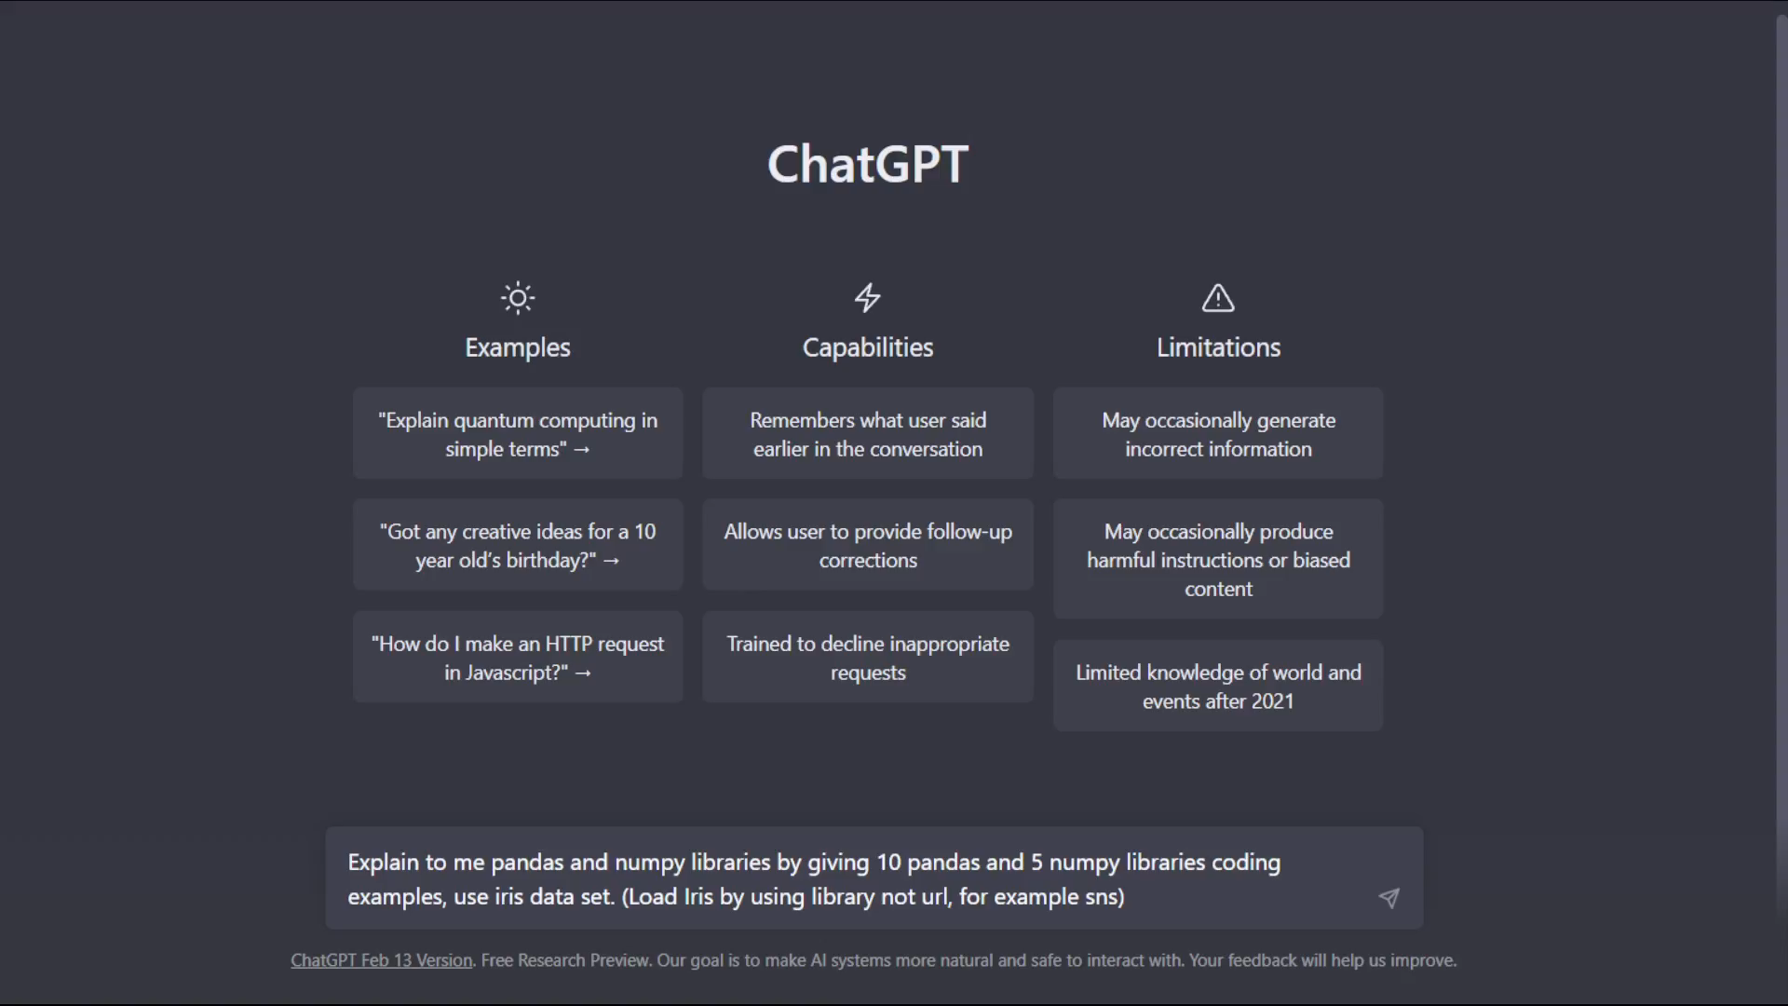

Slide 8
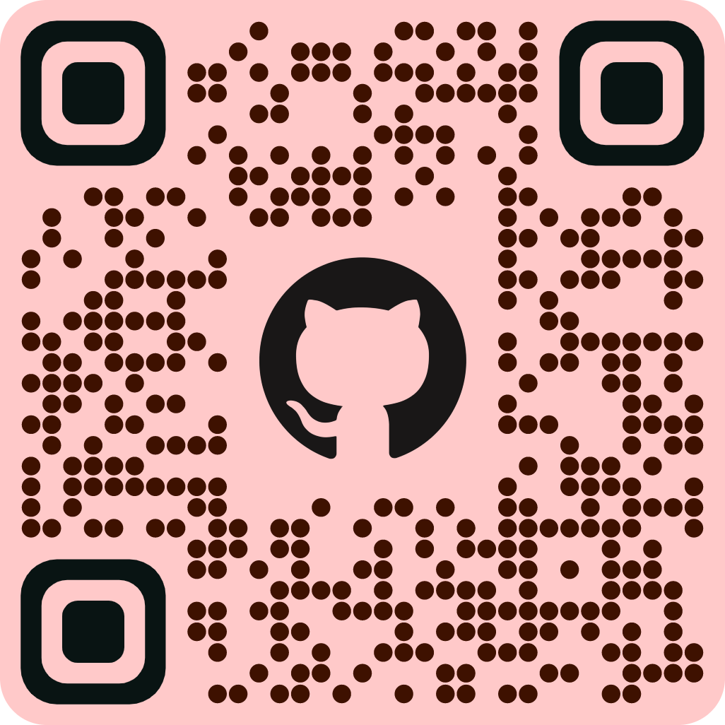
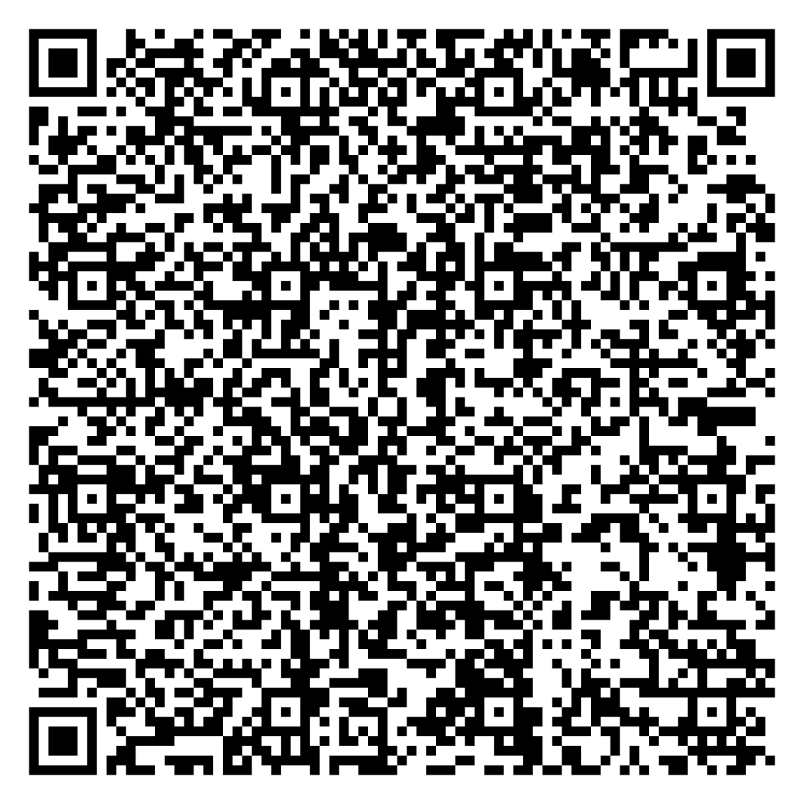
Our References

Slide 9

Thank you

